Slide 1


Journey to the stadium: a chatbot and facial emotion detection solution
Presented by: Aksah Kowsor(UOB:22009878),Awais Hussain(UOB:22008829)

Slide 2

Project 2 objectives/Chatbot Fundamental
Research the Raza architecture and recreate an existing solution
Research on facial emotion
Identify the different ways of booking a ticket for international matches
Identify and select interviews
Design of the chatbot flow (diagram)
Design of the facial emotion detection ( flow of steps)
Build the chatbot and test
Build the generic facial emotion
Manipulate interview videos and extract frames.
Evaluate both solutions
Creating a use case diagram

Slide 3
Overview
Introduction of who we are and what we will be presented for this project.
Project Aims and Objectives for project two.
Chatbot concepts of intent, entity, story, and action.
Agile project management approach
Chatbot conversational flowchart
Technical approach
Risk Assessment/ Agile test plan template
Solution evaluation and technical details
Managing our projects
Sprint Retrospective
Sprint Plan Template
Summary

Slide 4
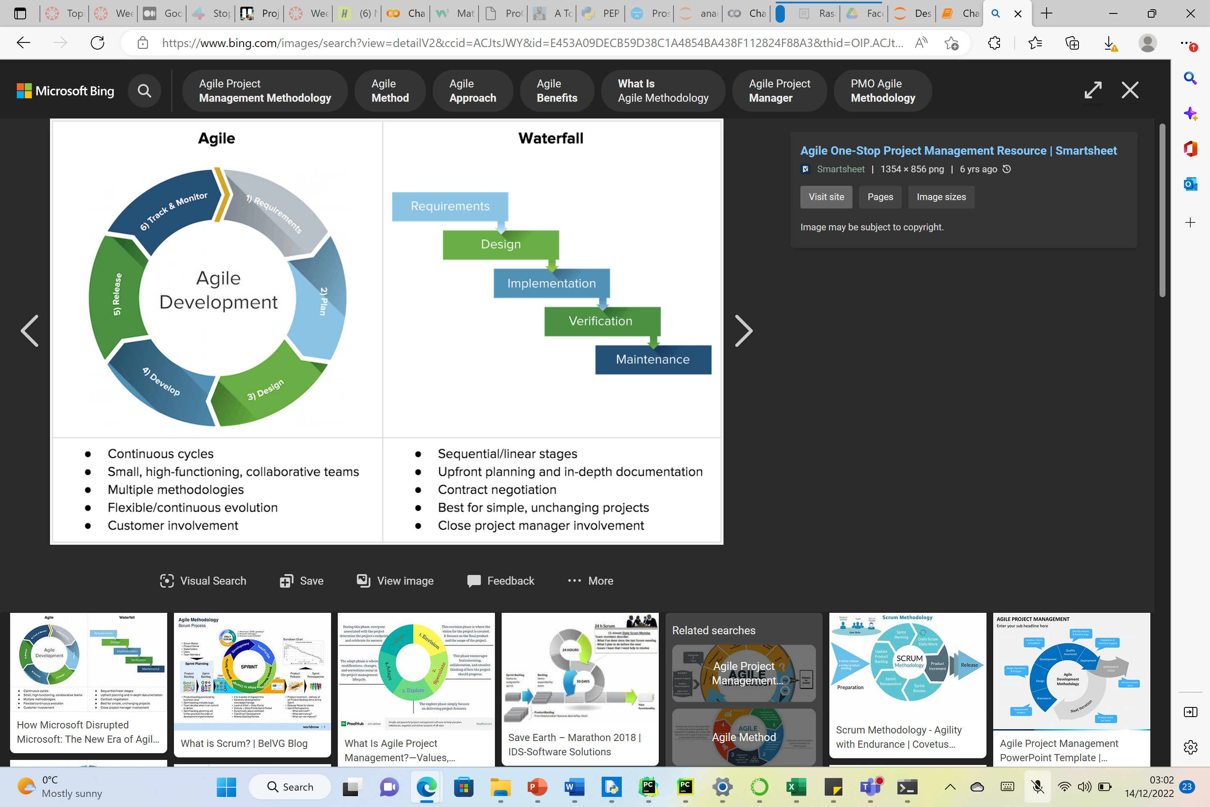
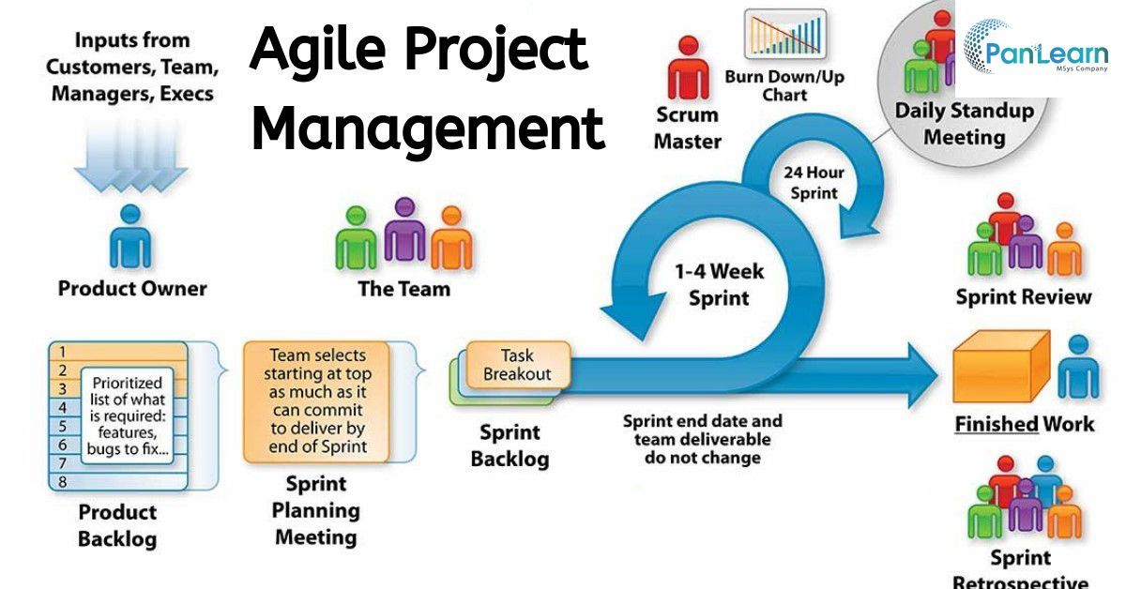
Agile project management approach
Notes:
Agile project management has continuous improvement. 1-requirements, 2-plan, 3-design, 4-develop, 5-release, 6-track and monitor. Whereas waterfall cycle sicks to one project and is best for unchanging projects leading to a poor model and no refinements but new requirements must be written for the model.

Slide 5
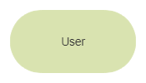
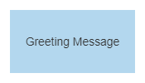
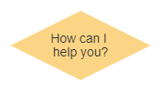
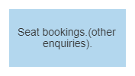
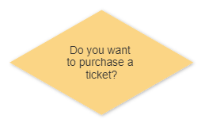
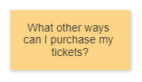
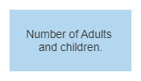
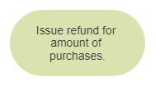
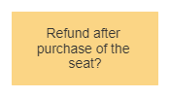
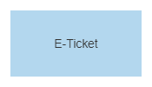
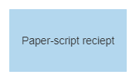
Flowchart
Chatbot
Facial emotion detection
No
Yes
Yes
No
Notes:
Chatbot flow chart:
The message is received and passed to an Interpreter, which converts it into a dictionary including the original text, the intent, and any entities that were found. This part is handled by NLU.
The message is passed from the Interpreter to the Tracker. The Tracker is the object which keeps track of conversation state.
The current state of the tracker is sent to each policy.
Each policy chooses which action to take next.
The chosen action is logged by the tracker.
A response is sent to the user.

Slide 6
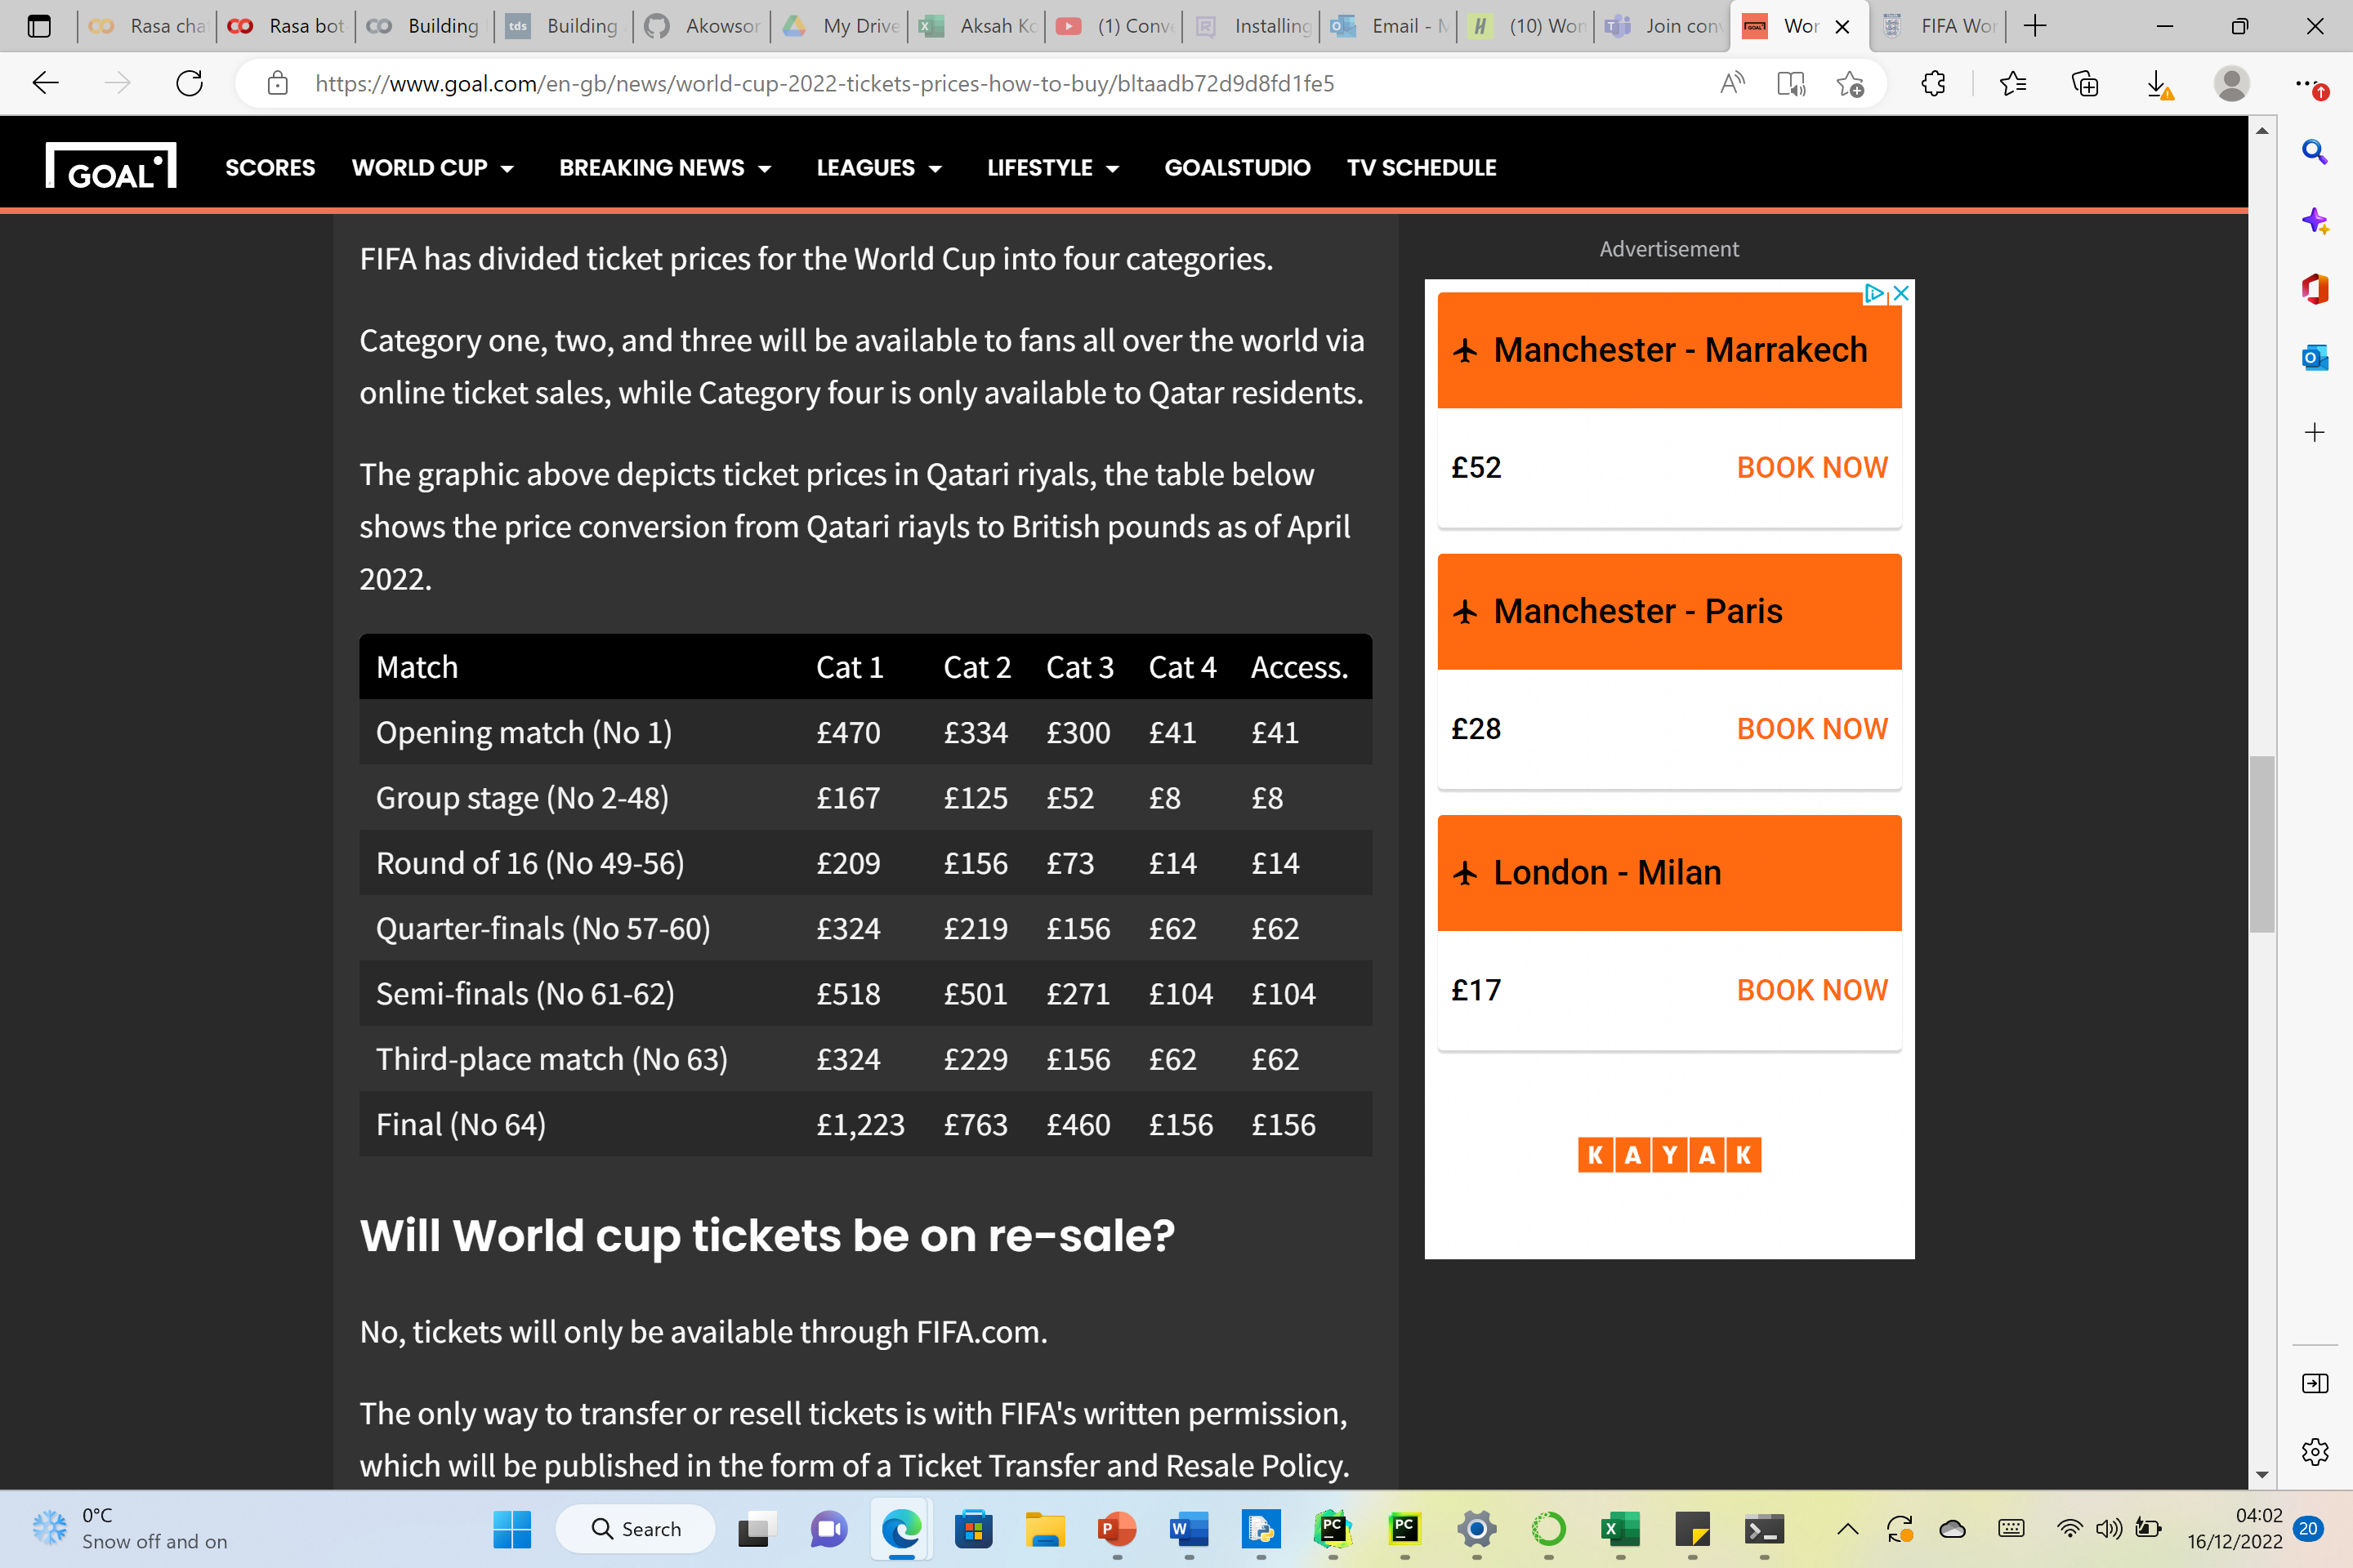
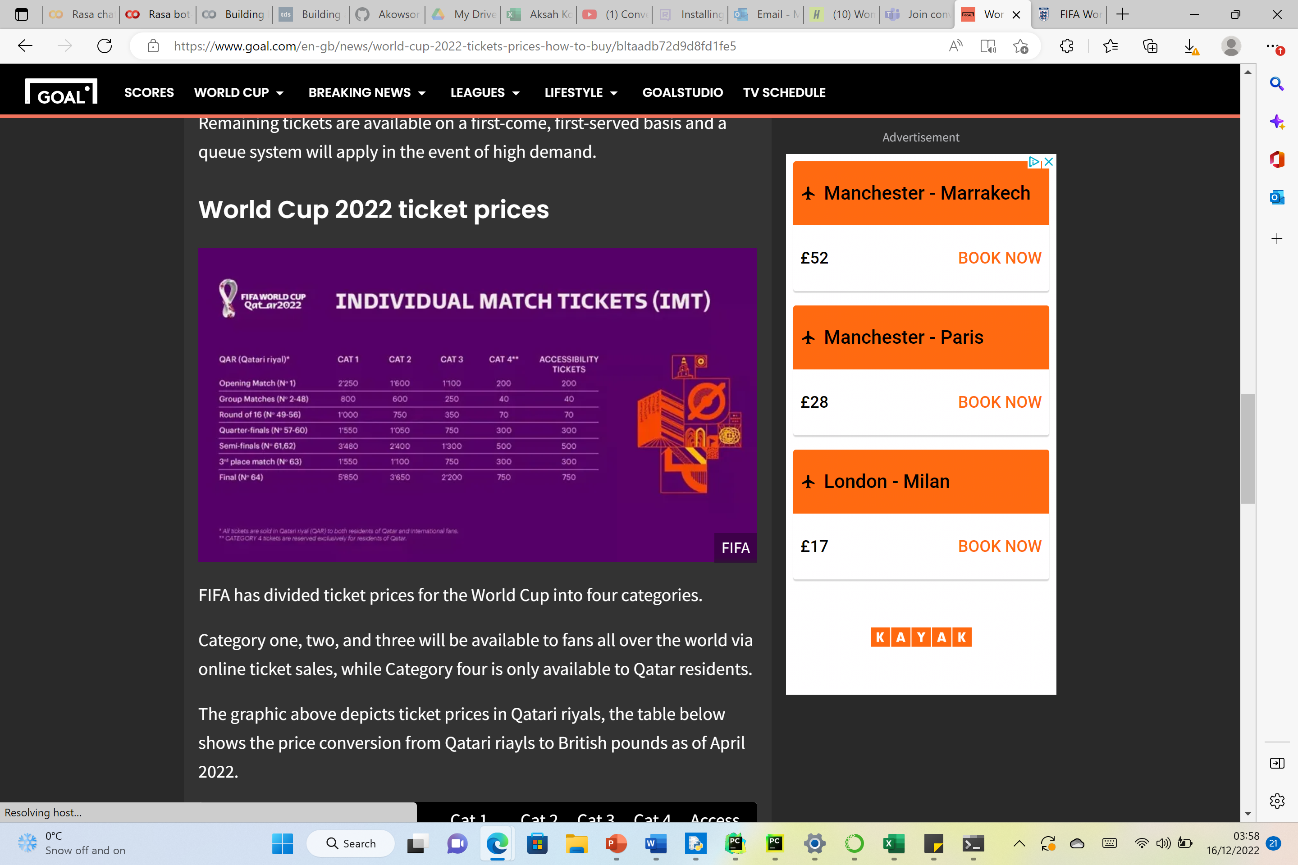
Ticket prices
Notes:
-purchase tickets on the official FIFA website
-purchase online tickets
-random selection draw sales period(Ticket Portal). Before buying a ticket users need to read through the football FAQS page.

Slide 7
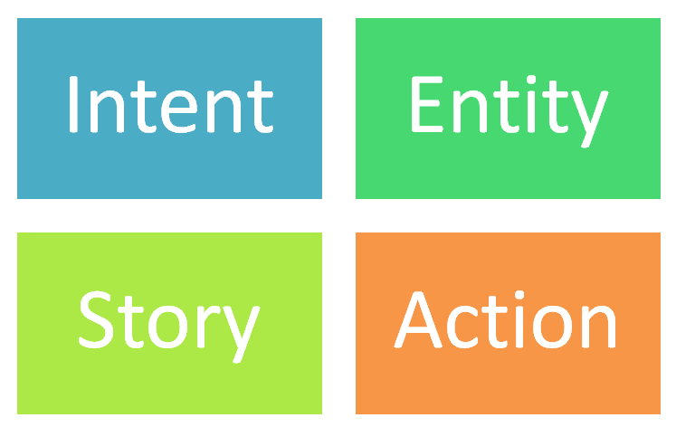
Chatbot concepts
Notes:
Intent-What is the user intending to ask about?
Entity-What are the important information in the users query?
Story-What is the possible way the conversation can go?
Action-What action should the bot take upon a specific request?

Slide 8
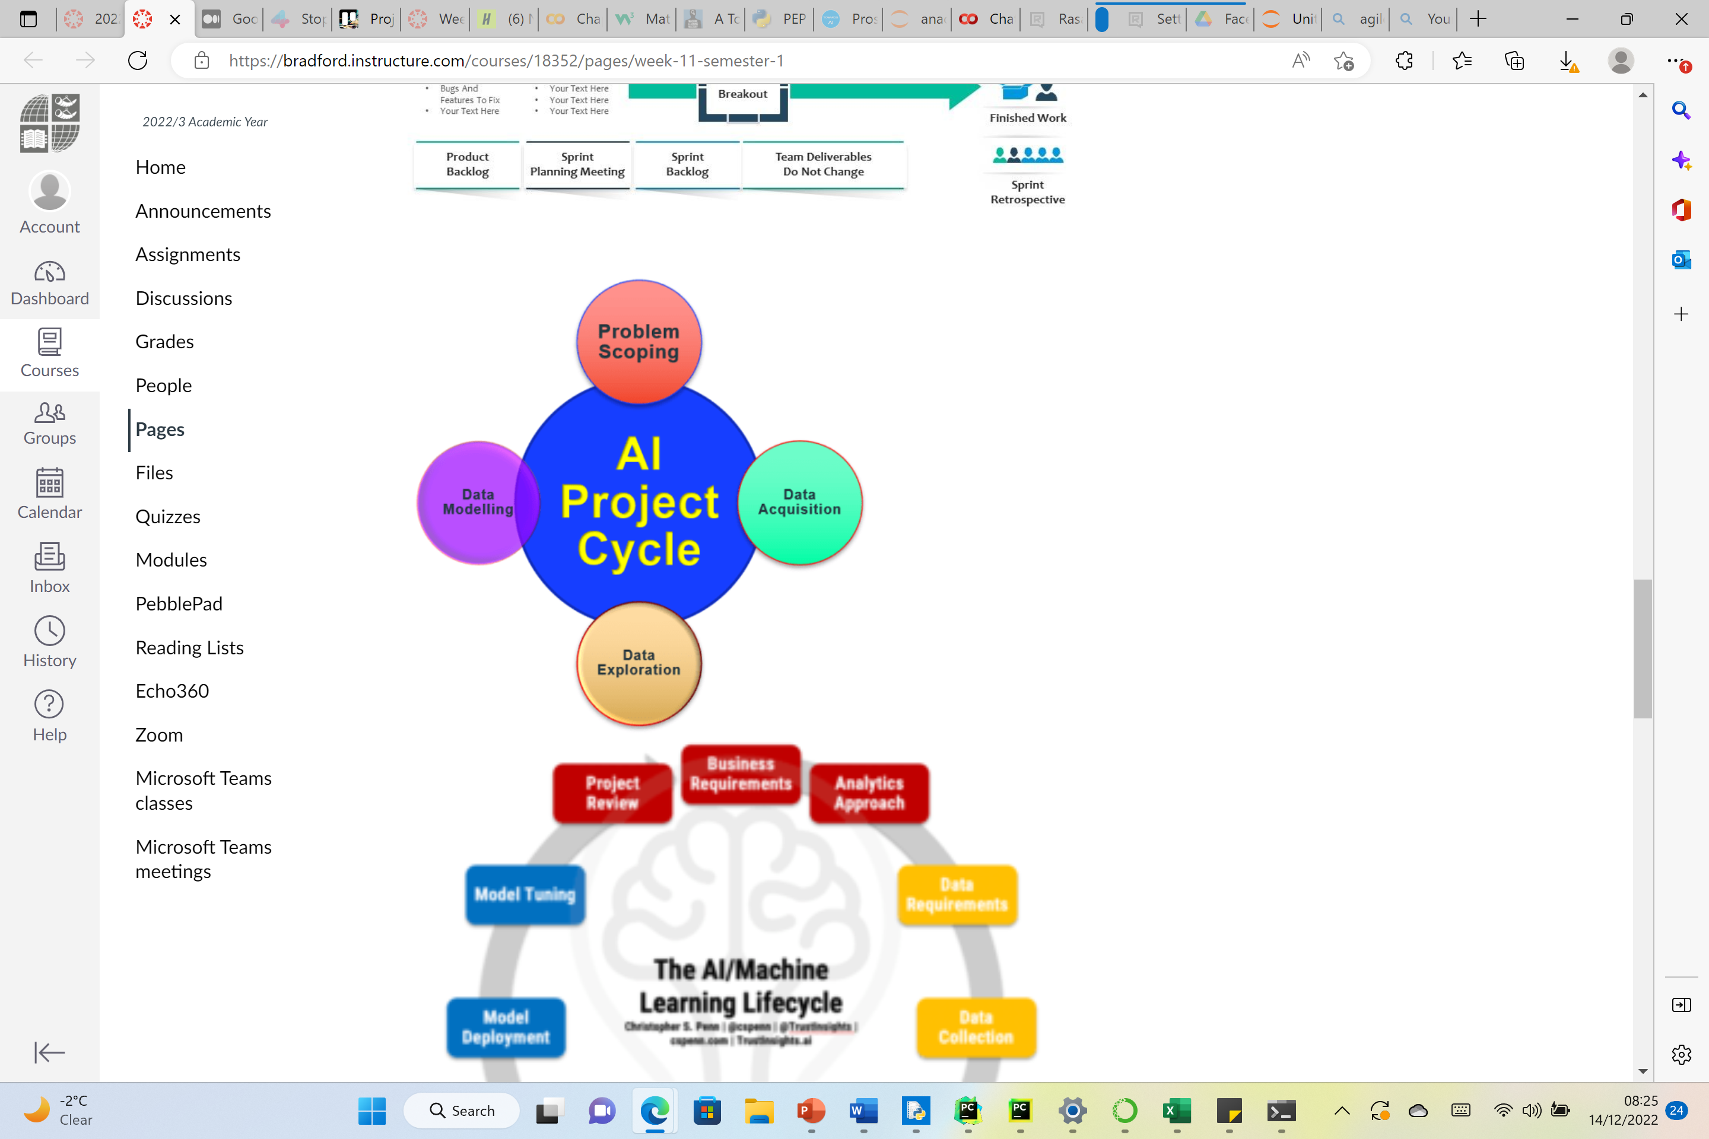
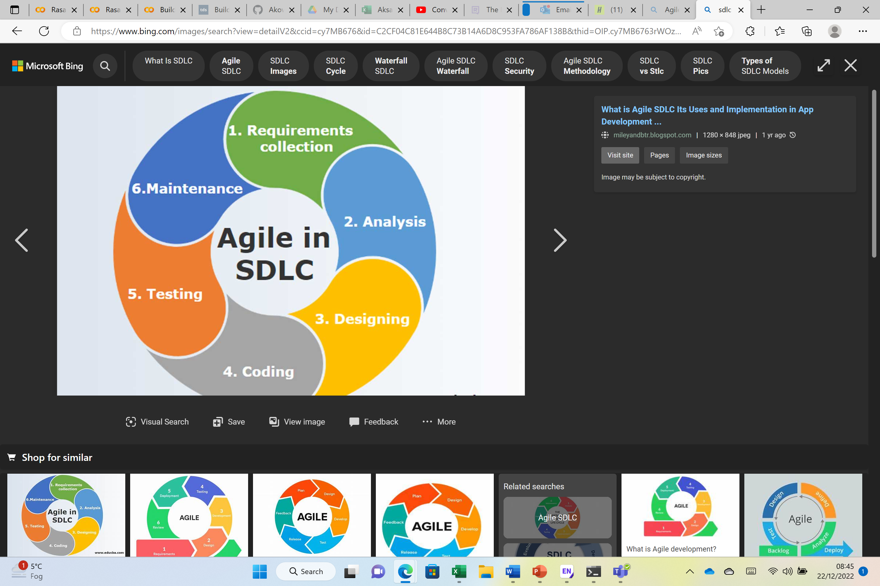
Technical approach slide
Notes:
research/analyses/redisgin it.
SDLC (Chatbot), AI Project Lifecyle for Facial Emotion Detection Systems

Slide 9
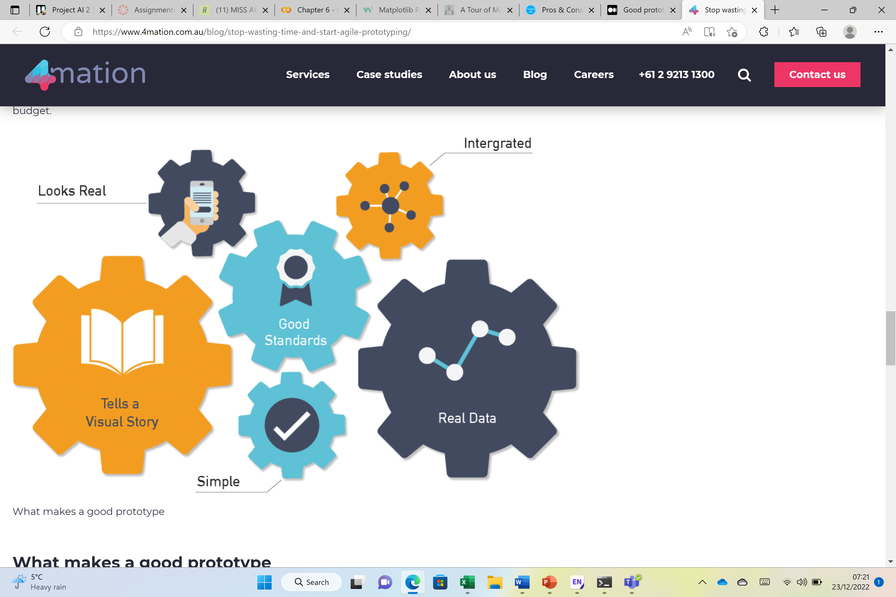
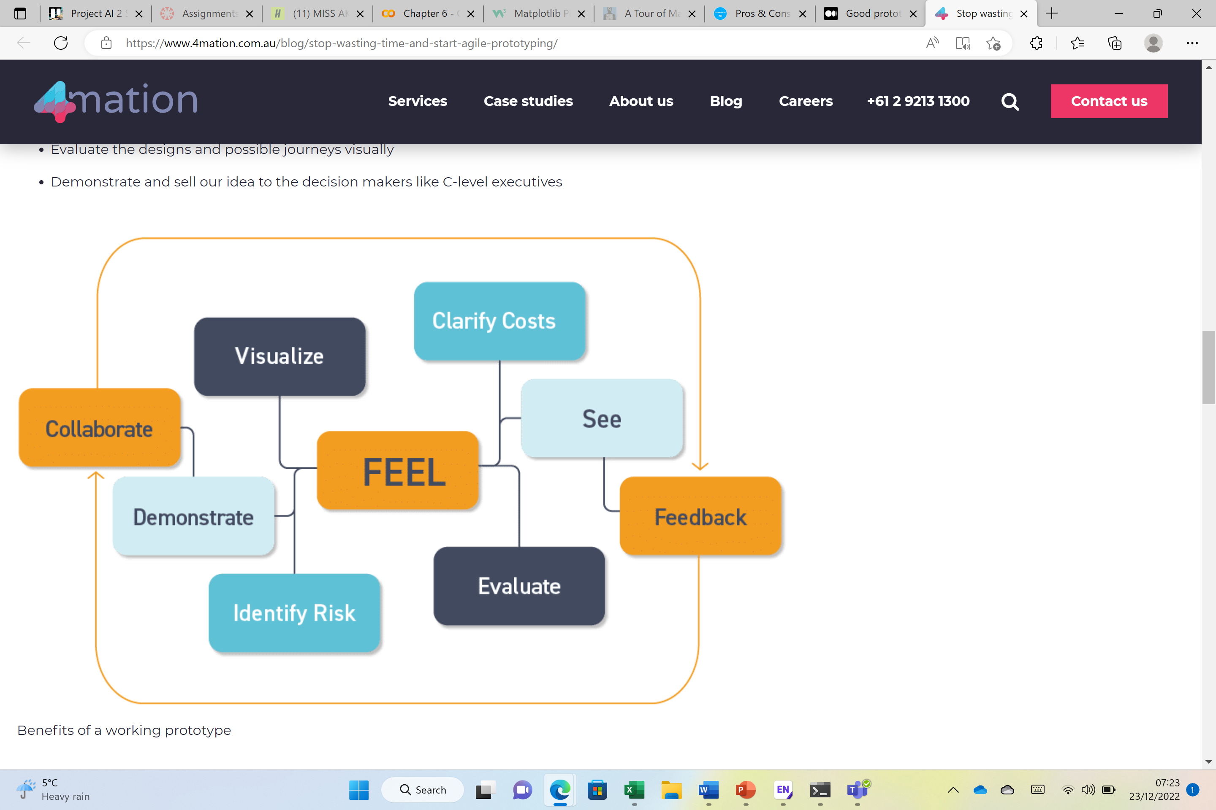
Evaluating the solution
Chatbot | Facial Emotion Detection Good prototype verse bad-does it meet my user requirements?(Facial Detection Emotion)(Business value, Usability and content)
Proposed solution must be promising
Knowing the cost to materialize my idea
Preparing and sending RFP to business partners or vendors
Collaboration should evolve around feedback and improvement
Early engagement with all key stakeholders
Allow stakeholders to take a visual user journey
Good prototype adapts to real-life settings with realistic content
Business Value : Up-sell
Usability: ensure the design of the chatbot works as intended for the users to use.
Content: product performance gives an output of the user and bot conversation.
Notes:
Read: agile prototyping and evaluation Read evaluation of the prototype: Good prototype vs bad prototype Does it meet the customer’s requirements briefly – in terms of Slide - evaluating your solution - 3 criteria Business value, usability and content. Add other criteria
https://www.4mation.com.au/blog/stop-wasting-time-and-start-agile-prototyping/
Good prototype vs Bad prototype. A couple of thoughts on how to approach… | by Galina Ryzhenko | Medium

Slide 10
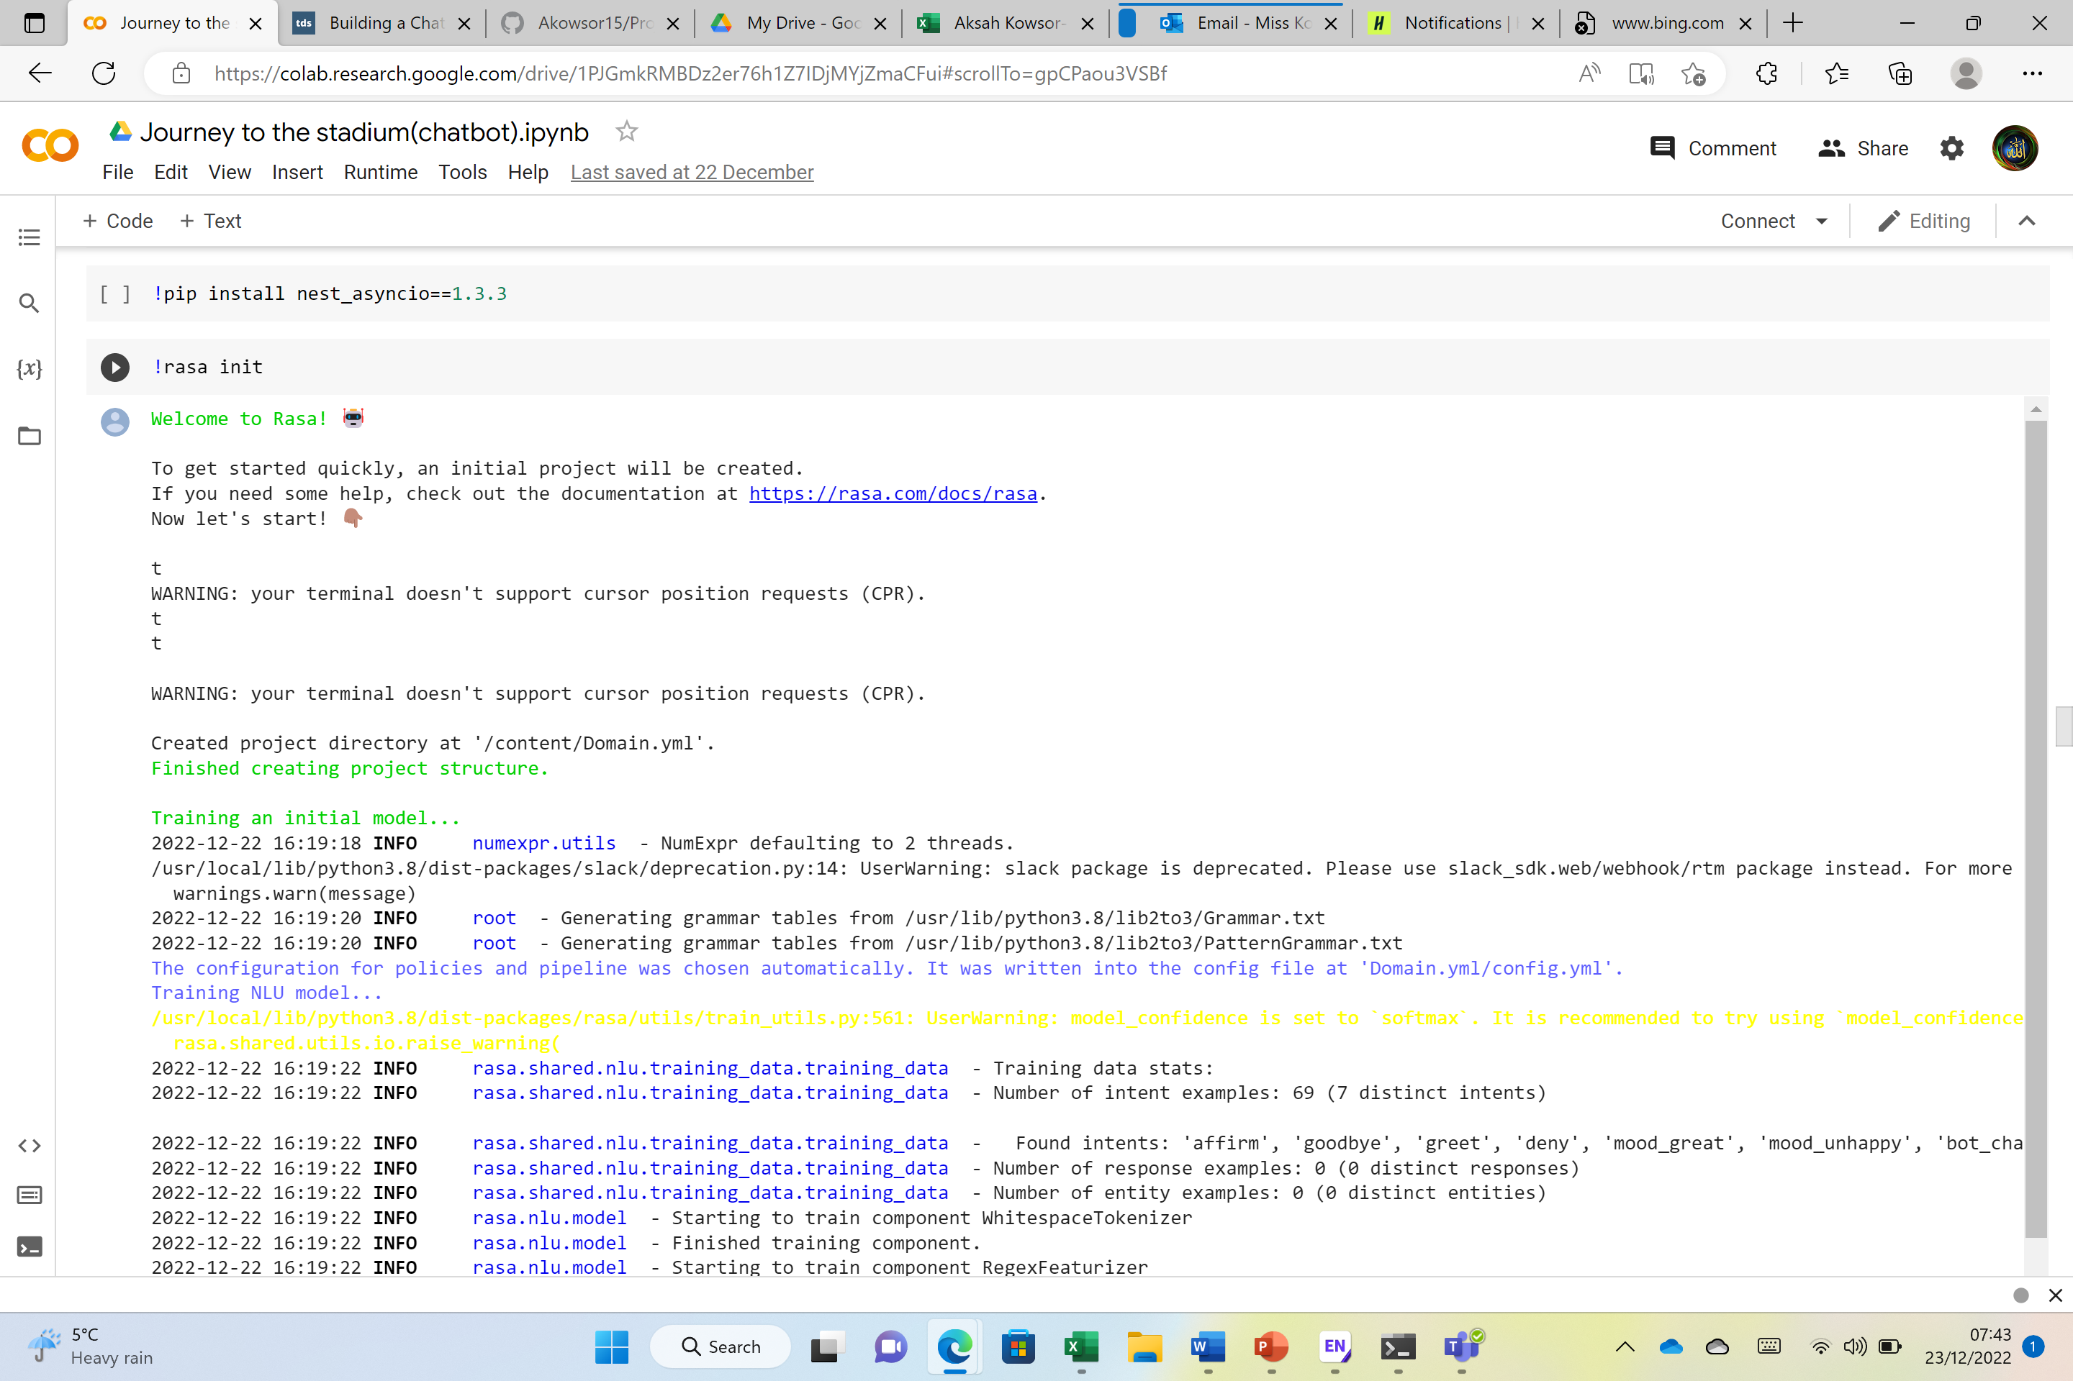
Technical details
Chatbot | Facial Emotion Detection How the data was acquired and the opportunities of the dataset. Comments on Algorithms and theories applied Review of tools and techniques including libraries used and considered.
Installing Rasa
Installing Rasa spacy
Upgrading Rasa new version
Installation of API, supports streaming data interference
Rasa in it for storing repository
Jupyter notebook as backup for code storing and testing
Anaconda, installation of all apps in one
Notes:
one slide on: Selection of the dataset – why, how it is acquired, opportunity of the dataset 2. Comments on the Algorithms, models, and theories applied 3. Review of Tools and techniques (including libraries) used and considered

Slide 11
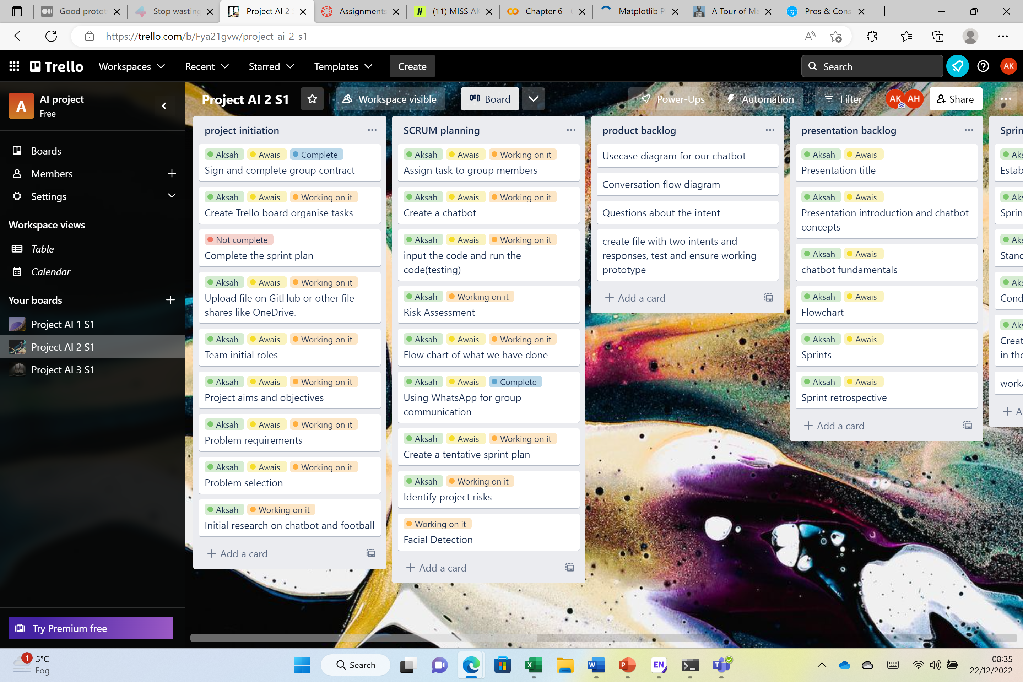
Managing our Projects

Slide 12
Risk Assessment
Risk Identified | Risk type | Risk Effect | Risk probability | Resolution
Hardware/software issues | Key pointers for the use in technology | This can lead to a delay in completion of creatin the chatbot and face detection. | Medium | Ensure the right hardware/software is being used, ensuring the product is tested and backed-up.
Poor communication between group members/people risk | People in the group | This can lead to the wrong tasks being assigned and a lack of support or help in the group. | Medium | Have a back-up communication method like Wats-app keep each other updated using a Trello Board.
Poor communication between client and group | People in the group | This can lead to a wrong final product, differing from what the client has asked the developers to produce. | Low | Keep each member in the group updated and note down what exactly the client is wanting and run the code also showing the steps to the client to ensure the group is on a right track.

Slide 13
Agile test plan template
St NO. | Module | Sub module | Pre Requisite | Steps to be followed | Expected result | Actual result | Comments | Status pass/fail

Slide 14
Sprint Plan Template
Sprint No | Sprint Goal | Sprint Tasks | Start Date | End Date | ScrumMaster | Daily Stand-up 1 | Daily Stand-up 2 | Daily Stand-up 3 | Sprint Review
1 | Installing Anaconda successfully and installing jupyter notebook | Installation of Rasa, Anaconda, and Jupyter notebooks. | 21/12/2022 | 25/12/2022 | Aksah | Date: 21/12/2022 Meeting Time:11:30am-12:00 Managed to install Anaconda successfully. Blockers were having to update programmes so Anaconda can be installed completely. | Date: 22/12/2022 Meeting Time:11:30am-12:00 Yesterday we achieved successfully installation of Anaconda, today plan is to launch Jupyter notebook and input the yml files. Blockers is managing to complete all files. | Date: 23/12/2022 Meeting Time:11:30am-12:00 Yesterday we achieved successful launch of the Jupyter notebook app, today we plan to complete the yml files. Blockers is time. | Date: 23/12/2022 Meeting Time:9:00am Review, discover and rearrange information
2 | Inputting files for codes in, NLU Data, Response, Stories, Forms, and Rules. | Creating intent for the chatbot. | 26/12/2022 | 28/12/2022 | Aksah | Date: 26/12/2022 Meeting Time:11:30am-12:00 Yesterday we achieved a successful completion of creatin repository, today plan is to create a story. Blocker is time for creating a catchup meeting. | Date: 27/12/2022 Meeting Time:11:30am-12:00 Yesterday we achieved completion of building a story for our chatbot. Today plan is to complete the rest of yml files. Blocker is time along with lack of communication. | Date: 28/12/2022 Meeting Time:11:30am-12:00 Yesterday we achieved completion of creating the rest of repository. Today we plan to input the libraries and codes to create a conversational flow between the user and the chatbot. Blockers are managing to input the code and running the code to get an accurate result as there was a bracket missing to close a sentence. | Review, discover and rearrange information
3 | Gathering dataset images and video files for facial emotion and detection testing to see if files can get uploaded and if emotions o people faces can get detected. | Testing image dataset and video files for detection of emotions. | 29/12/2022 | 31/12/2022 | Awais | Date: 29/12/2022 Meeting Time:11:30am-12:00 Yesterday we achieved to gather image datasets in relation to Qatar FIFA world cup 2022. Today plan is to gather files of videos and testing it. Blocker is time. | Date: 30/12/2022 Meeting Time:11:30am-12:00 Yesterday we achieved to test the emotion detected on faces. Today plan is to input different expressions of what other features can be detected. Blocker is sufficient research. | Date: 31/12/2022 Meeting Time:11:30am-12:00 Yesterday we achieved to complete most of the research and detection of facial features. Today plan is to get accurate results from the dataset and figure out if features ca be detected if the person face is not in light. Blocker is technical issue. | Review, discover and rearrange information

Slide 15
Sprint Retrospective
What worked well? Research on dataset images Initial research on chatbot Upload of Google Collab file onto GitHub Trello board updates Group collaboration | What could be improved? Communicating between group members Keeping each other updated on time and replying back to messages Completing short tasks first then moving to the hard ones
What will we commit to doing in the next sprint? Keeping the team members updated quicker Completing the research first and plotting out tasks needed to be done on the Trello board | What actionable commitments are made by the SCRUM team? Keeping each team member updated consistently If one needs help the other should put their effort in to help achieve the impossible Backing up files to other team members

Slide 16
Summary
What have we achieved? Completion of tasks to do Collaboration to complete the tasks Solution completion Analysing dataset images for facial detection and emotion Analysing chatbot system and codes used to get an output | What have we learned? Updates of the project initiation are a must Lack of communication can lead to lac of help, that will lead to an incomplete finalized project Goals and deadlines Execution of projects Support between team members is crucial
Chatbot
Facial Emotion Detection
https://colab.research.google.com/drive/1PJGmkRMBDz2er76h1Z7IDjMYjZmaCFui?usp=sharing
FIFA final world cup - Jupyter Notebook
Journey to the Stadium - Jupyter Notebook
Journey to the Stadium - Jupyter Notebook

Slide 17

Thank you for listening any questions?

Slide 18
Reference
(K.Panesar), Chatbot concepts, week 8 chatbot architecture, and rasa fundamentals and rasa lab work, (Accessed 12/12/2022).
https://www.smartsheet.com/sites/default/files/agile-vs-waterfall-chart.png
https://unibradfordac-my.sharepoint.com/:i:/g/personal/kpanesar_bradford_ac_uk/EW8sNireR-hLhvB8DHHIc-QBBoNUlEMwS_LkHzkte4pXvg
(K.Panesar), AI project lifecycle, AI project Design and Development, Week 11 Semester 1, Accessed(14/12/2022).
FIFA CUP image, This Photo by Unknown Author is licensed under CC BY-SA
FIFA cup and ball image, This Photo by Unknown Author is licensed under CC BY-SA
(N.Khairi), World cup tickets 2022: prices and how to buy, World Cup 2022 tickets: Prices & how to buy | Goal.com UK , Accessed(16/12/2022).
https://editorialge.com/wp-content/uploads/2021/11/agile-sdlc.jpg,Agile in SDLC, Accessed(22/12/2022).
(B.Bayley),07/Nov/2017, Stop wasting time and start agile prototyping, Stop wasting time and start agile prototyping | 4mation, Accessed(23/12/2022).
(G.Ryzhenko), 04/10/2019, Good prototype vs Bad prototype, Good prototype vs Bad prototype. A couple of thoughts on how to approach… | by Galina Ryzhenko | Medium, Accessed(23/12/2022)

